Slide 1
Secure pork supply, AgView and ASF
Dr. Patrick Webb

Slide 2
Secure Pork Supply (SPS) Plan: What it is & how to get it fully implemented

Slide 3
Secure Food Supply Plans Movement from Premises with No Evidence of Infection
Secure Milk Supply (2009-2017)
Foot and Mouth Disease (FMD)
Movement of milk
Secure Pork Supply* (2010)
FMD, Classical Swine Fever, African Swine Fever
Movement of animals
Secure Beef Supply (2014)
FMD
Movement of animals
All funded by USDA APHIS
*Funding also provided by the Pork Checkoff
Notes:
The SPS Plan is one of several Secure Food Supply Plans funded by USDA APHIS. The Pork Checkoff has also provided funding for the SPS Plan. The Secure Milk and Secure Beef Plans both address Foot and Mouth Disease Outbreaks whereas Secure Pork addresses Foot and Mouth Disease, Classical swine fever and African swine fever.

Slide 4
Common Components of Secure Food Supply Plans
Developed with input from industry, state, federal, and academia
Voluntary pre-outbreak preparedness
Biosecurity
Surveillance
Traceability
Movement permit guidance
Risk assessments
Completed and in process
Guidelines
Notes:
The common components across all the Secure Food Supply Plans include the Voluntary pre-outbreak preparedness components, biosecurity, surveillance, traceability, movement permits and risk assessments.

Slide 5
Diseases in the SPS Plan

Slide 6
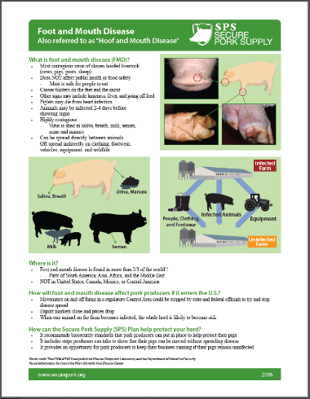
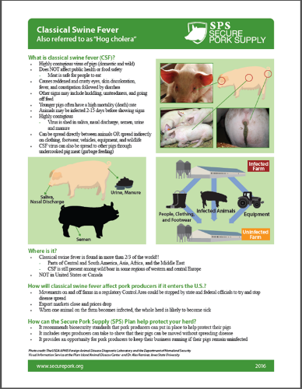
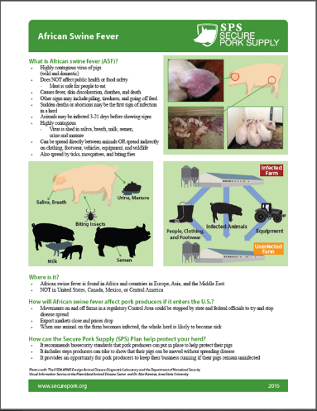
Secure Pork Supply Plan
www.securepork.org
Notes:
The three diseases included in the SPS Plan include foot and mouth disease, classical swine fever, and African swine fever. One page handouts are available on the Secure Pork website explaining each the three diseases. Videos are also being developed for each of the diseases. These diseases are not a public health or food safety concern.

Slide 7
Biosecurity

Slide 8
Biosecurity
Four concepts emphasized
A Biosecurity Manager
A written site-specific biosecurity plan
A defined Perimeter Buffer Area
A defined Line of Separation
Notes:
The biosecurity checklist and information manual for enhanced biosecurity emphasize four concepts that all pork production sites must implement to help protect their animals from endemic diseases and to be prepared in the event of an FAD outbreak in the U.S. They include a Biosecurity Manager, a written site-specific biosecurity plan, a defined Perimeter Buffer Area, and a defined Line of Separation. Let’s breakdown each of these four concepts.

Slide 9
Biosecurity Manager
Use the Self-Assessment Checklist and Information Manual for Enhanced Biosecurity
Write site-specific biosecurity plan (with the assistance of the herd veterinarian)
Include a site-specific map
Train employees
Ensure compliance on the site
Notes:
A lesson learned from the HPAI outbreaks is that we need to make sure biosecurity measures are being followed on the site. All the secure food supply plans are adding a Biosecurity Manager. The Biosecurity Manager needs to be familiar with the facility. He or she will use the self-assessment checklist and information manual to write the site-specific biosecurity plan. Employees will need to be trained in biosecurity. The biosecurity manager would ensure that training takes place. This individual would be someone at the site who can monitor compliance.
The Biosecurity Manager can be an owner or site manager, veterinarian, or employee on site. If a system has one Biosecurity Manager for multiple sites within the system, then the on-site manager is responsible for ensuring that the biosecurity procedures for that site are followed.

Slide 10
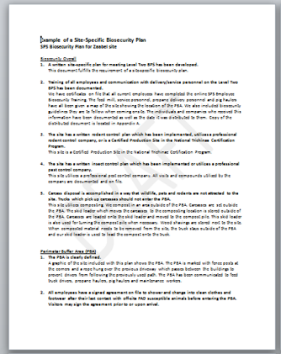
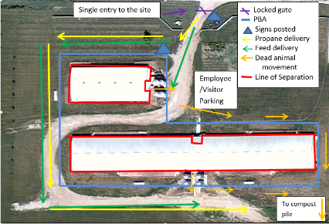
SPS Plan Biosecurity
Create a Site-Specific Biosecurity plan
explain how the site meets all the biosecurity measures listed in the checklist
Notes:
The site-specific biosecurity plan needs to explain how the site has implemented the biosecurity measures listed in the checklist. It must include a site map with several items which need to be included on the map such as parking, the perimeter buffer area and the line of separation.

Slide 11
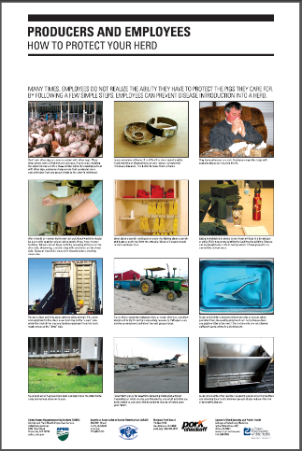
Biosecurity Posters
Producers and Employees
Visitors
English and Spanish
Laminated copies at the pork store
www.securepork.org
Notes:
Biosecurity posters are available as PDF files on the website in both English and Spanish. Producers can also order free laminated copies of the wall charts to post in their buildings from The Pork Store.

Slide 12
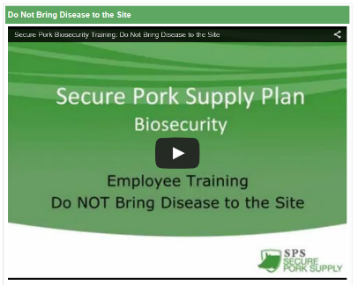
Employee Biosecurity Training
Biosecurity Topics:
Introduction
Do not bring disease to the site
Perimeter Buffer Area
Line of Separation
Personal Protective Equipment
Notes:
Employee training on biosecurity is essential in order to increase compliance. Employees need to understand what is expected of them and basic biosecurity concepts. Companies can continue to use existing biosecurity training or five biosecurity training lessons will be available soon. Each lesson is under 5 minutes in length and can be watched individually or in a group setting like during an employee meeting.

Slide 13
Traceability

Slide 14
SPS Plan: PIN
Get PremIDs or PINs
Request from the office of your State Animal Health Official
Include a valid 911 address, latitude and longitude
Verify PIN is associated where the animals are located
Associate the PIN with animal movements and diagnostic laboratory submissions
Notes:
Producers can prepare by getting a premises identification number or PIN. This PIN can be requested from the office of your State Animal Health Official. The PIN includes a valid 911 address and a set of matching coordinates as well as the latitude and longitude reflecting the actual location of the animals on the premises. Having a validated PIN will speed up communication and response during an outbreak. If you already have a PIN, it would be good to verify that the PIN is associated with the actual location of the animals. Another way to prepare is to start putting you PIN on all diagnostic laboratory submissions and animal movements.

Slide 15
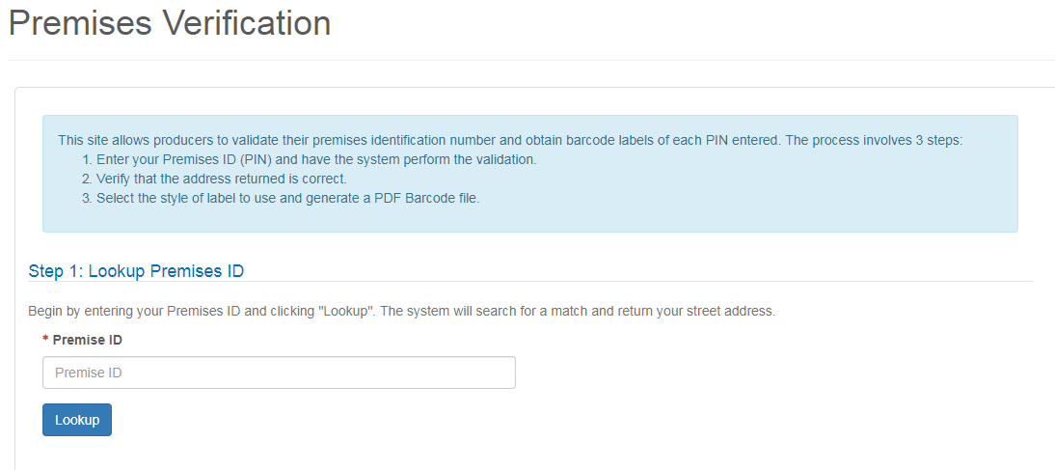
SPS Plan: PIN
https://lms.pork.org/Premises

Slide 16
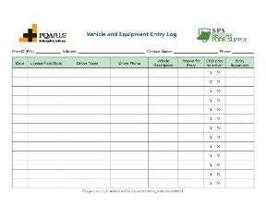
SPS Plan: Record Keeping
Record animal movements
Maintain a visitor logbook
Be prepared to track movements onto the site
Electronic records preferred
Notes:
Producers can prepare by making sure they are recording animal movements, maintaining a visitor logbook and track other movements on the site such as visitors and equipment. Keeping these records electronically is ideal, but paper copies are also available on the website which can be utilized. As you can see here, some forms include both PQA Plus and SPS logos, so they may be very similar to forms you are already using.

Slide 17
Surveillance

Slide 18
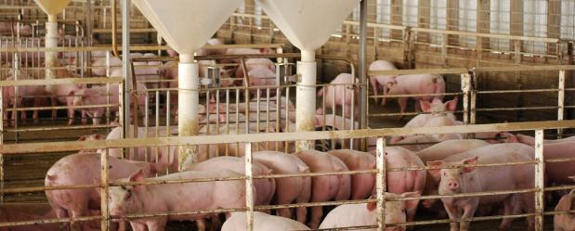
SPS Plan: Surveillance
Swine Health Monitors
Caretakers trained recognize abnormal production parameters or clinical signs suggestive of FMD, CSF, and ASF
Look for these parameters and clinical signs on a daily basis
Notes:
If your farm is in a regulatory control area, surveillance may include periodic inspection by regulatory officials or your herd veterinarian. You can help with this process by looking for the production parameters and clinical signs associated with FMD, CSF, or ASF in the animals in your herd. Animal caretakers look over their animals on a daily basis. Caretakers can review the clinical signs associated with the diseases and look for them on a daily basis. Observing these clinical signs or changes in production should raise concern. Make sure the caretakers know who to contact immediately whether that be a site manager, veterinarian, or the regulatory officials.

Slide 19
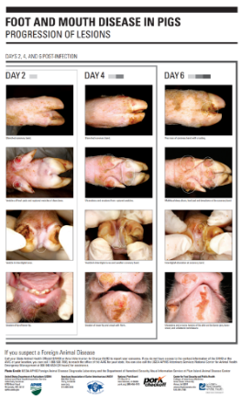
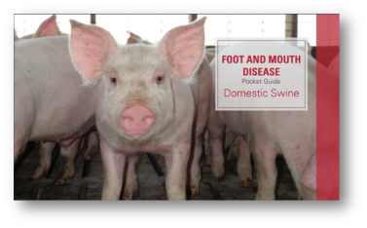
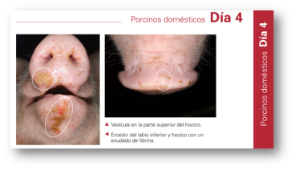
FMD, CSF, and ASF Lesion Posters
Available in English and Spanish
www.securepork.org
Notes:
Several resources available to help caretakers understand the clinical signs associated with the three diseases. Wallcharts addressing FMD, CSF, and ASF are laminated so they can be disinfected and hung in the barns for animal caretakers to see on a daily basis and be reminded of the clinical signs associated with these diseases. They are available in English and Spanish. Wall charts can be ordered free of charge from the Pork Store. PDFs can be downloaded from the securepork.org website.

Slide 20
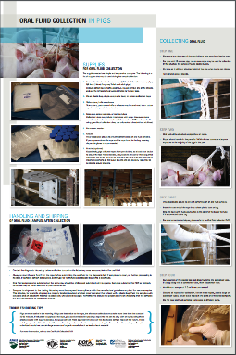
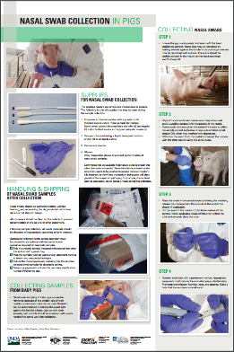
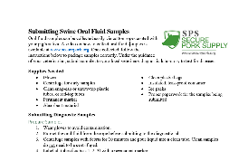
SPS Plan: Surveillance
Work with veterinarian to determine if caretakers are prepared to collect their own samples if permitted
www.securepork.org
Notes:
Surveillance may include both diagnostic testing and observations. Information is available on the securepork.org website on how to collect oral fluid samples and nasal swabs in the event caretakers will be allowed to collect these samples during an outbreak.

Slide 21
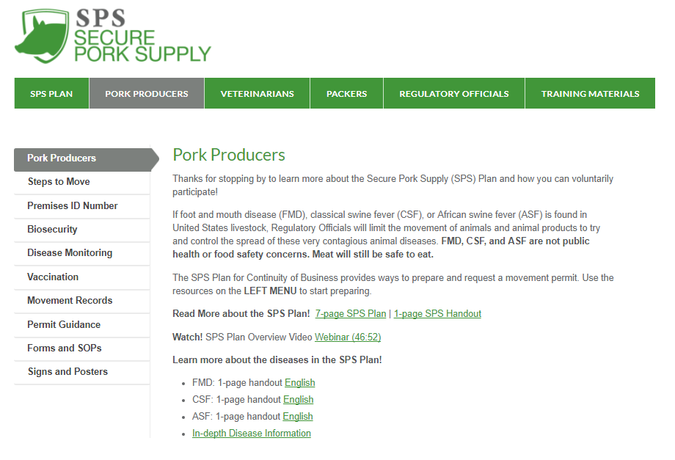
Summary
What we can do today?
Biosecurity
Manager, plans, training
Traceability
PINs, Recordkeeping
Surveillance
Monitors, training
Communicate with your State Animal Health Official

Slide 22
The AgView System
Pork Checkoff is funding the development of AgView
Central platform
Producer permissioned sharing
Rapid, efficient and secure
Day-to-day utility

Slide 23
African swine fever (ASF) task force
NPB’s swine health committee considers keeping ASF out of the U.S. a top priority.
Developed tactics aimed and reducing risk of entry
Taskforce formed to prioritize and guide tactic implementation
Weekly calls
Focus on strategies and resources
Keeps tracks of progress

